Slide 1
Zero-Resource Super-Resolution for Diffusion-Weighted Prostate Images
Batuhan Gundogdu^{1,2} , Milica Medved^{1,2} , Aritrick Chatterjee^{1,2}, Grace H. Lee, Nisa Cem Oren, Aytekin Oto^{1,2}, Gregory S Karczmar^{1,2}
¹Department of Radiology, The University of Chicago, Chicago, IL, United States, ²Sanford J. Grossman Center of Excellence in Prostate Imaging and Image Guided Therapy, The University of Chicago, Chicago, IL, United States

Slide 2
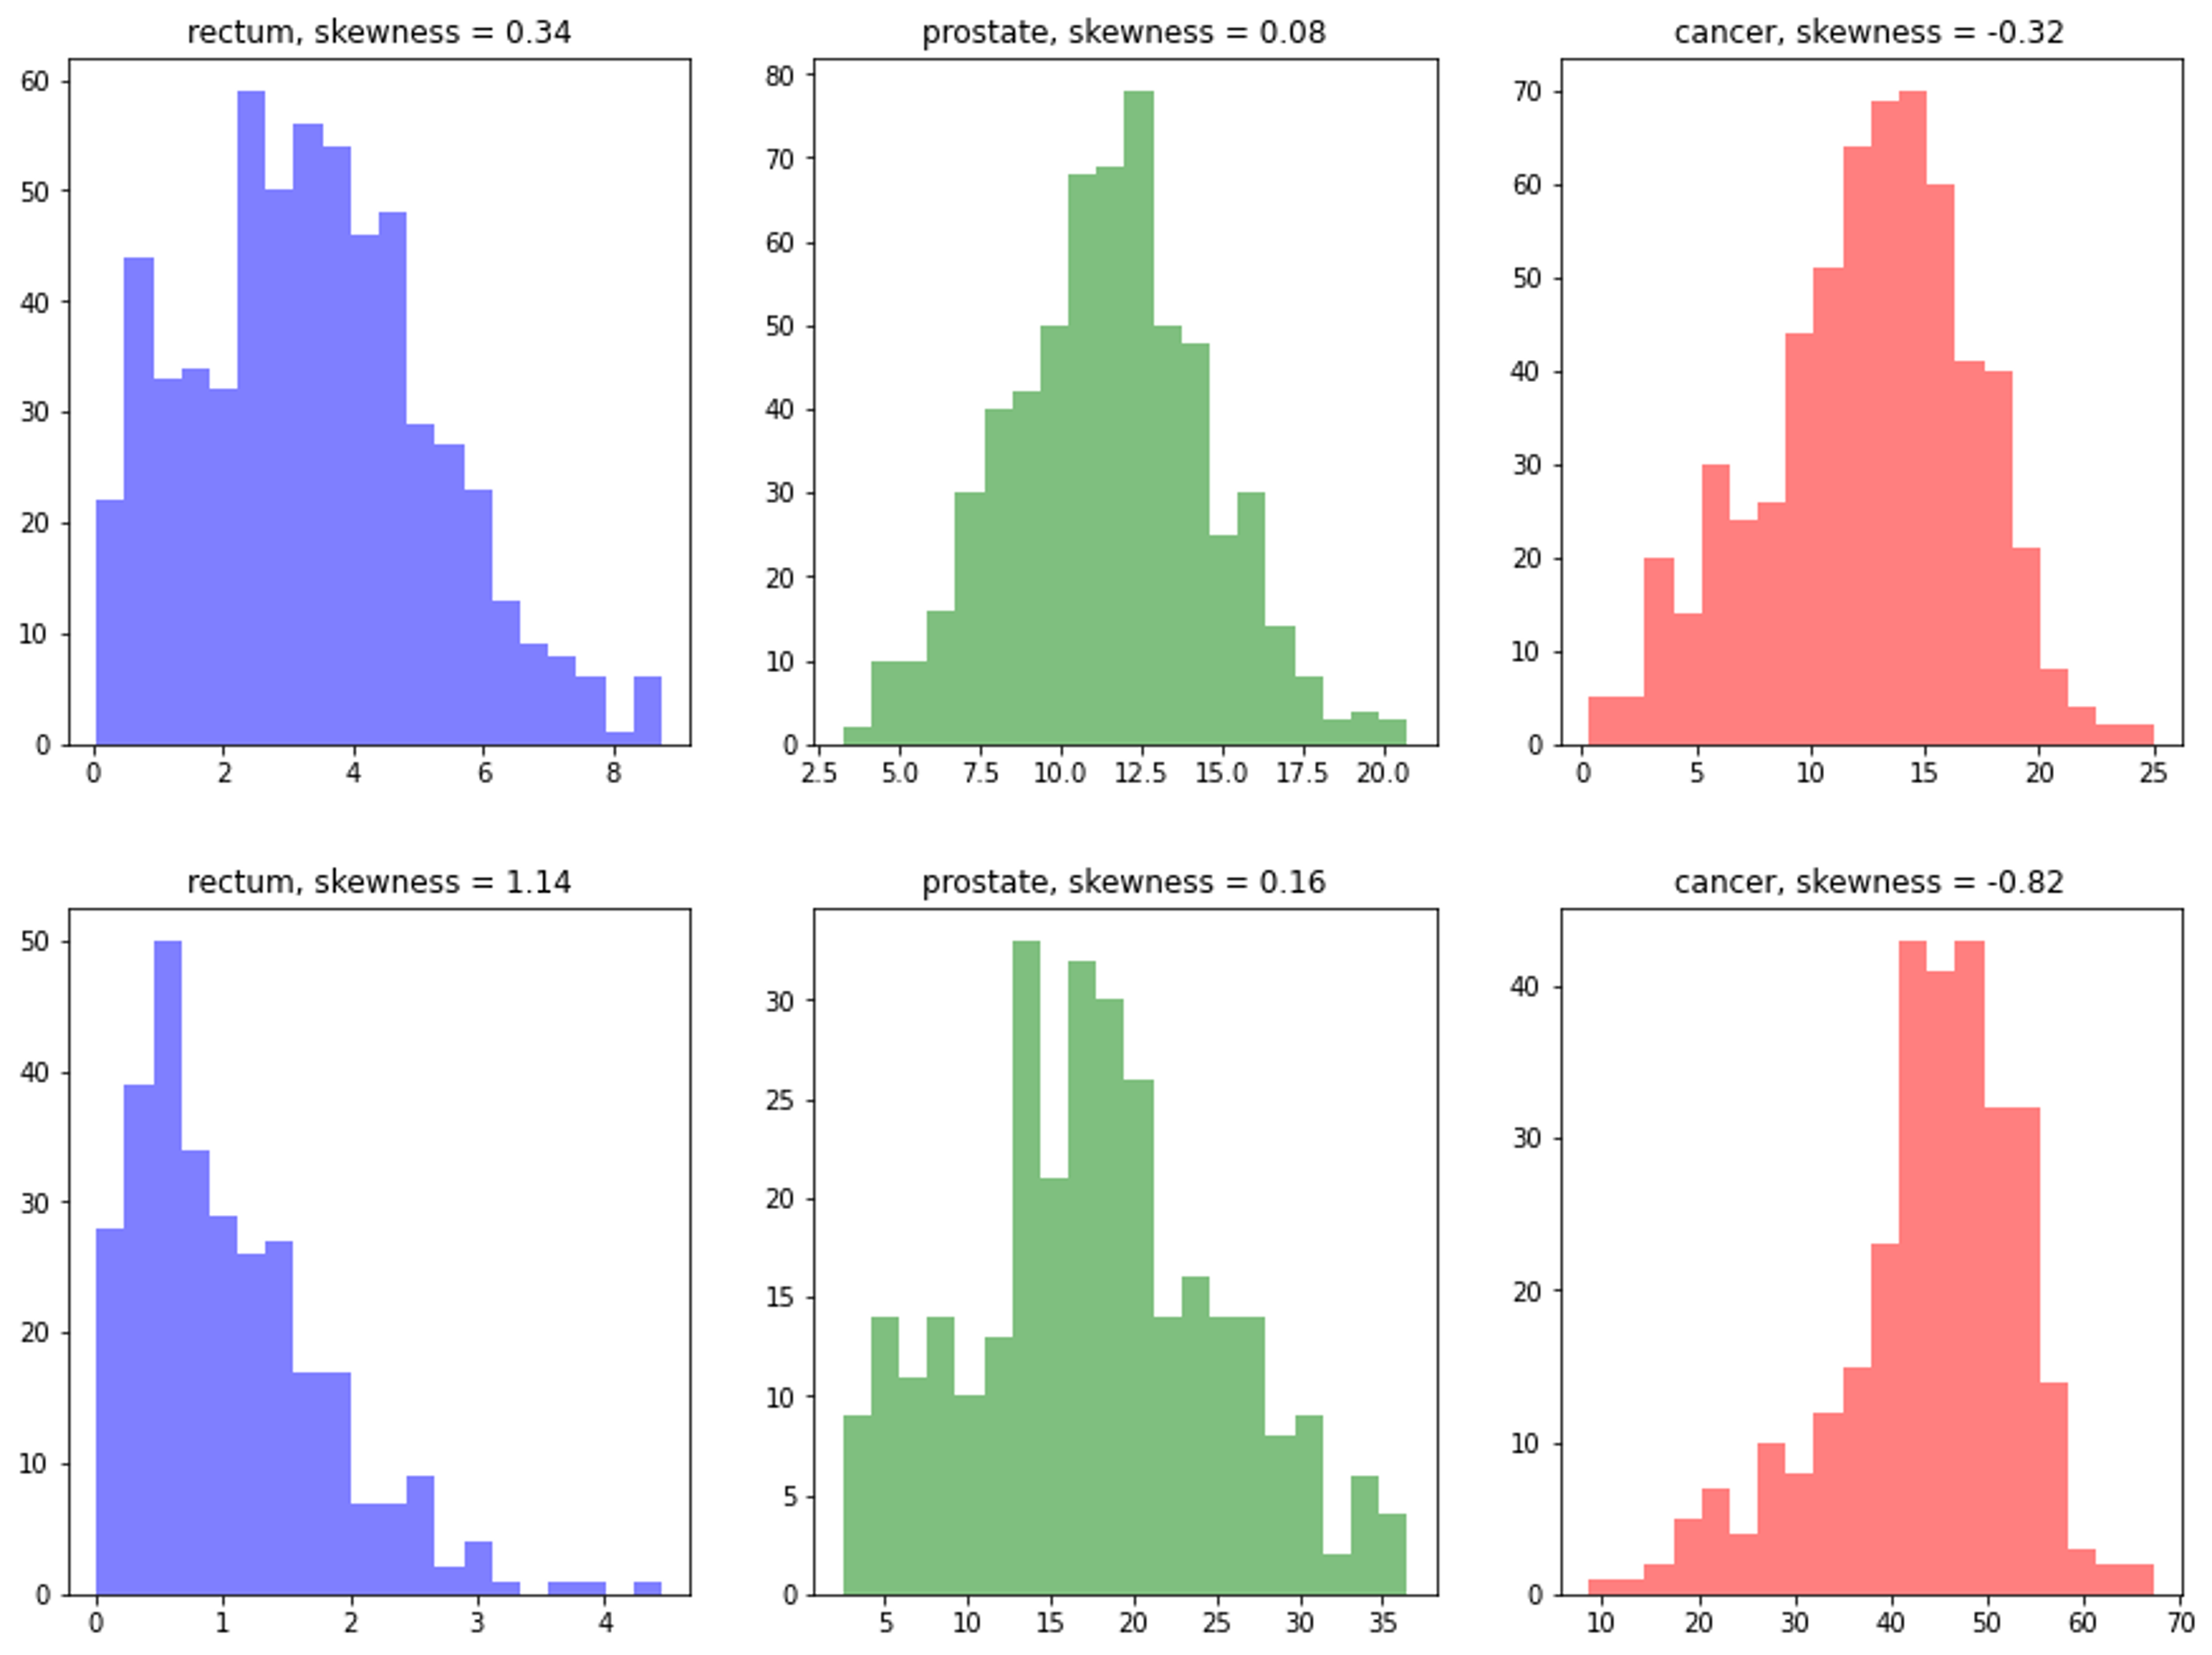
Introduction:
DWI are typically obtained as multiple acquisitions with multiple diffusion-sensitizing gradient directions to increase SNR.
Motion during and between application of diffusion sensitizing gradients can result in loss of signal and therefore direct-averaging of the multiple acquisitions obscures regions with restricted diffusion.
Image from Gundogdu et.al. “Directional and inter-acquisition variation in DWI and editing for restricted diffusion”, Mag. Res. In Medicine, 2022.
Notes:
(45) Since Diffusion weighted have lower SNRs in addition to lower resolution they are obtained as multiple acquisitions and their average is taken to improve SNR.
However, the molecular motion caused by arteries, or the bulk motion of the prostate happening during and between diffusion sensitizing gradients results in a loss of signal. The direct averaging of acquisitions obscures regions with restricted diffusion.
We have recently studied the extend and the effects of this directional and inter-acquisition variation in DWI. On the image you can see the inter-acquisition distributions of voxel diffusion signals calculated over rectum with blue, healthy prostate with green and cancer with red.

Slide 3
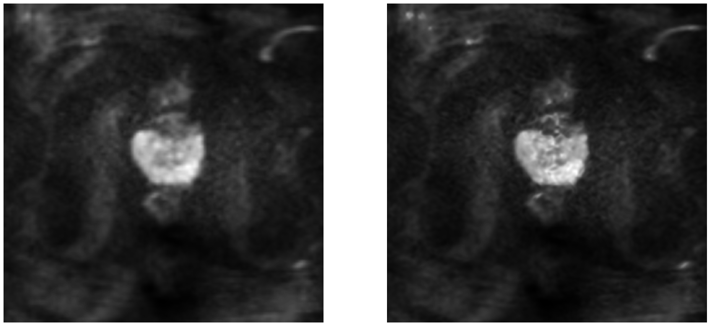

Goal:
Make use of the multiple acquisitions to train a neural network and achieve higher spatial resolution as well as higher diffusion-coefficient resolution
Super-res
average
Notes:
(1:20) We thought that we could make use of these multiple acquisitions to obtain something better than taking their average. So the purpose of this study is to make use of the multiple diffusion acquisitions to achieve higher spatial resolution and better signal representations – better tissue discrimination between healthy and cancer signals and therefore higher diffusion-coefficient resolution.

Slide 4
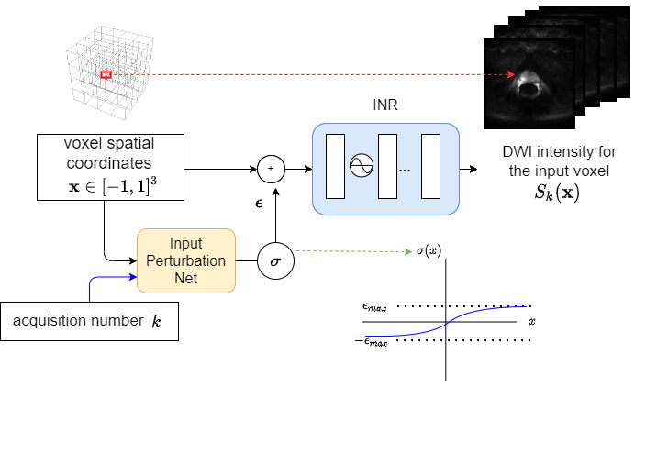
Trained with Implicit Neural Representation architecture, which does not require a large training set for SR and can be trained per image
Notes:
(2:20) By definition of the problem that DWI has inherently low resolution, a super-resolution training set of low-res/high-res pairs of diffusion images is not achievable. Therefore, we followed the implicit neural representation architecture. In this model, a high resolution analog image is assumed to be a mathematical function from the space of discrete voxel locations to the range of signal intensity values. The low-res image voxels are then discrete samples of this function. The goal is to learn the best representation of this function.

Slide 5
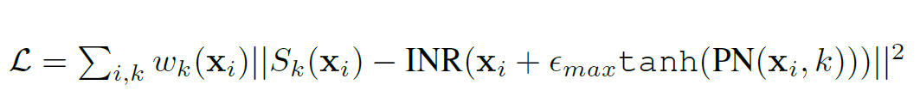
Trained with INR architecture, which does not require a large training set for SR and can be trained per image
Notes:
(3:00) Theoretically, this model with the blue box learns a globally-trained interpolation function. However, since we have multiple acquisitions of the same image, and if there are millimetric motions of voxels between this images, we can make use of these motions to obtain super-resolution. Therefore we introduce the input perturbation network with the yellow box, that “warps” the input image such that the total reconstruction loss is minimized. Furthermore, we can incorporate learning weights to the reconstruction loss such that the network gives less weight to potentially anomalous acquisitions due to motion-induced signal loss.

Slide 6
Quantitative and Qualitative Experiments
Baseline mean image
Enhanced SR image
Notes:
(3:45) Note that there is no need for high resolution labels for your data to implement this model. That’s why this study is classified as Zero-Shot super-resolution. Implicit neural representation neural network is trained with voxels of the LR image and it is called with a higher resolution grid of inputs to obtain a higher resolution image. However, The question as to whether the new detail that is introduced by the model corresponds to real anatomical detail or actual biomarkers still remains.

Slide 7
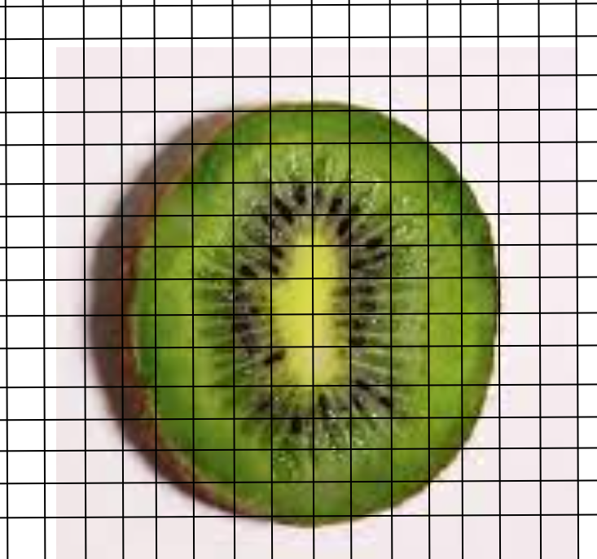
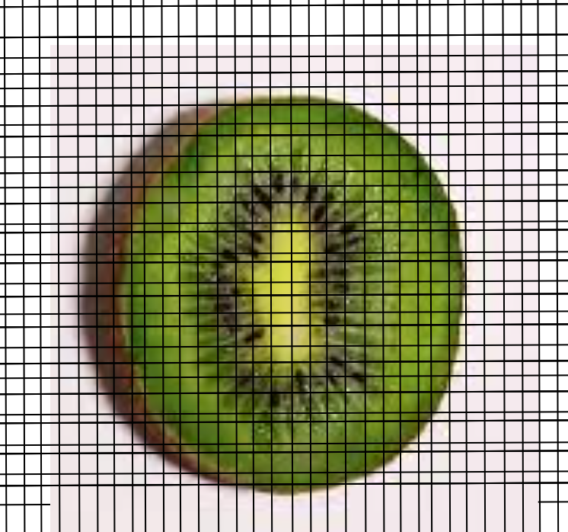
Phantom Experiments
Ground Truth
Input Image
Ultra-High Resolution Image
No motion,
27 acquisitions
With motion towards 8 main directions (N,E,W, S,NE,NW,SE,SW)
27 acquisitions total
No motion,
48 acquisitions
0.75 mm resolution
1.25 mm resolution
1.25 mm resolution
Motion up to 0.5 mm each direction
Notes:
(4:15) To test this, we implemented two sets of controlled experiments. In the first experiment, we took kiwifruit as a biological phantom, since it is considered by many groups to be a good proxy for prostate in terms of MRI. We scanned the phantom with no-motion and with a simulated motion along the main directions with less than a voxel size translational motion. We also obtained a ultra-high resolution scan to verify visually if the new detail that the model introduces is correct.

Slide 8
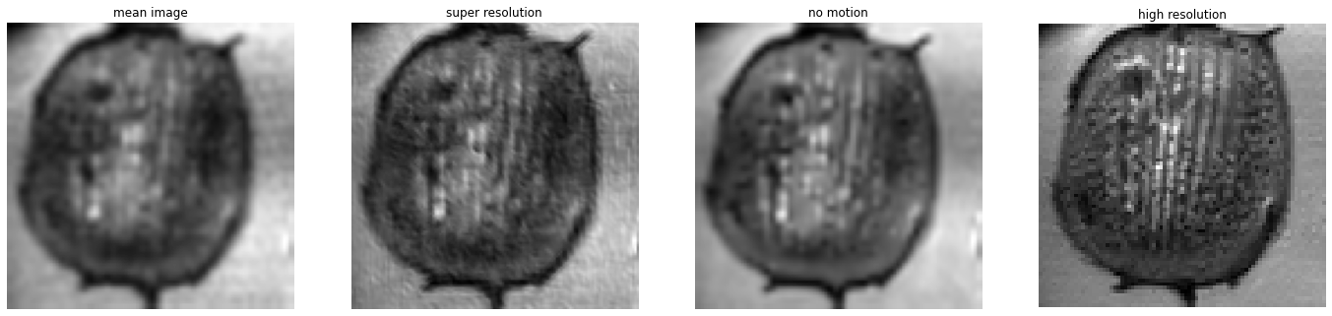
No-motion
input
SR
Ultra-High-Res image
Notes:
(5:15) The image on the left is the ground truth with no motion, the second image is the input image in which the motion is simulated by shifting the isocenter of the field of view at each acquisition. The super-resolution output clearly accounts for the motion through its Perturbation Network which was trained in an unsupervised fashion. Some of the new detail that is introduced does not even exist in the no-motion image, which we interpret as “This network converts motion into advantage”

Slide 9
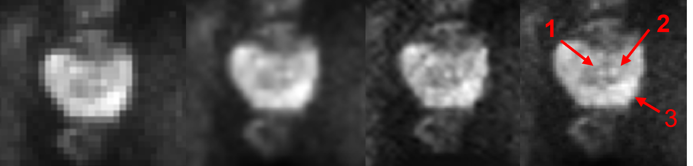
Experimental Results on Prostate DWI:
LR (input)
bicubic
SR
HR
Notes:
(5:40) When we apply the methodology prostate images, we can observe that the network enhances some detail that exist on the diffusion weighted prostate images. Arrows labeled 1 and 2 are ejaculatory ducts and 3 is cancer.

Slide 10
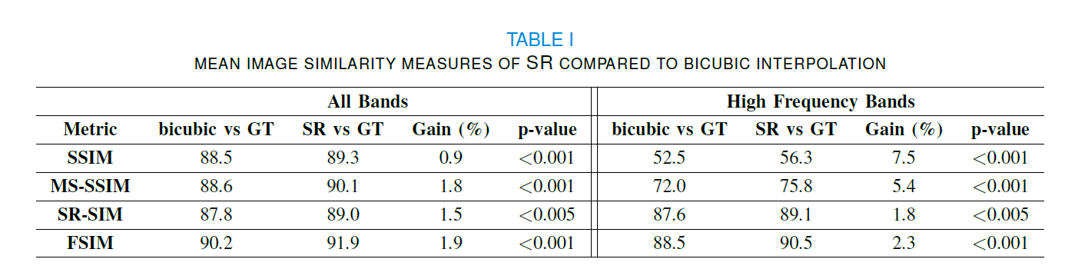
Qualitative Analysis
Quantitative Analysis
2 radiologists voted for perceptual quality of 65 images
96.1% of SR were voted to be better than interpolation.
Also 40.7% of SR were voted to be better than the HR image, which has twice the resolution and 4 times more voxels than super-resolution model’s input.
Calculated structural and feature similarity scores for the same 65 images
Also evaluated on 12 cancer patients
Cancer-to-healthy prostate contrast ratio
26%
Signal to noise ratio
3%
Notes:
(6:40) In order to conduct the qualitative and quantitative analyses on prostate images, we processed 65 sample images with and without cancers.
The high-resolution, super-resolution and interpolated versions of these images were presented to 2 radiologists in randomized order. The locations of images for each version are shuffled at each question to avoid biasing the observers. The radiologists were asked to rank the 3 images in terms of perceptual quality judging by several aspects (such as resolution, contrast, noise, discriminability of biological detail etc.) jointly
96.1% of the images with super-resolution enhancement were voted to have better perceptual quality than the interpolated image. Moreover, 40.7% of the enhanced images were voted to have better quality than the HR image, which has twice the resolution and 4 times more voxels than super-resolution model’s input. To evaluate the quantitative performance same set of 65 images were compared with the high resolution ground truth using the state of the art image similarity metrics. Super-resolution images were significantly more similar to high-res images than interpolated images were.
In order to evaluate the diffusion coefficient discrimination, We compared SNR on cancer as well as the cancer-to-healthy prostate contrast ratio metrics. Due to the weighted learning mechanism both SNR and contrast ratio were significantly better than the baseline image.

Slide 11
Conclusion
It is possible to obtain super-resolution with zero-shot deep learning, making use of motion between multiple acquisitions of diffusion MRI.
Weighted training mechanism can help account for motion-induced signal loss occurring at some of the acquisitions to increase susceptibility of restricted diffusion.

Slide 12
Questions?

Slide 13
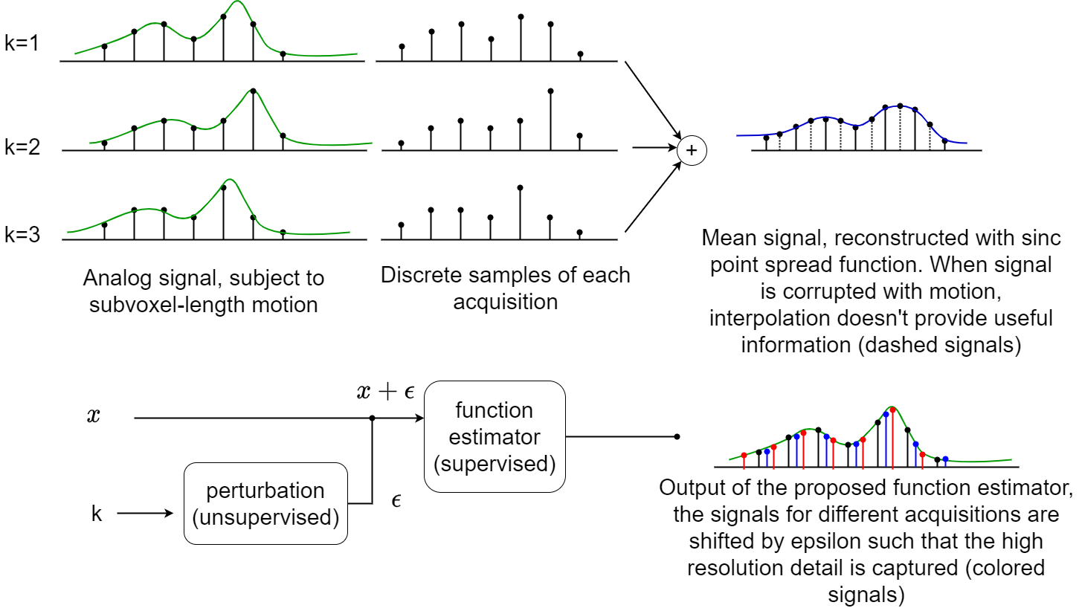

Slide 17
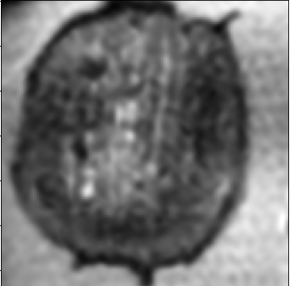
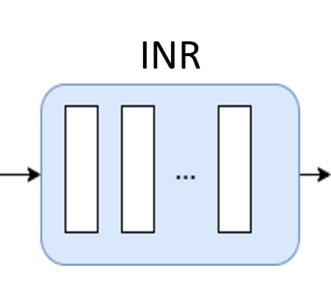
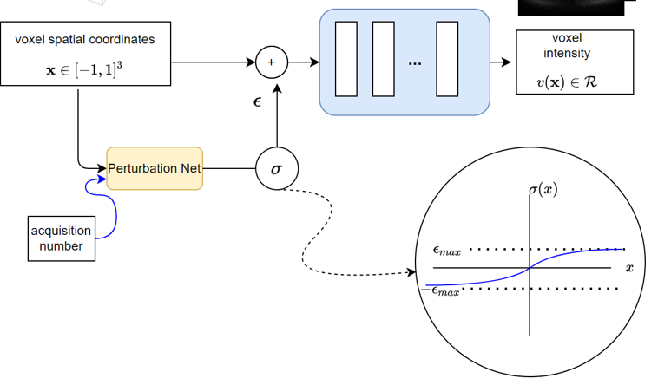
No-motion
with-motion
enhanced
enhanced++
Ultra-High-Res image
Notes:
The image on the left is the ground truth with no motion, the second image is the input image in which the motion is simulated by shifting the isocenter of the field of view at each acquisition. There are two outputs of the super resolution network, o

